Slide 1
Fake News Detection Project
Submitted by:
Ruchi Tiwari

Slide 2
Imported all these Libraries
Libraries- numpy, pandas, seaborn, matplotlib.pyplot, warning
#Pre-processing/ Cleaning the Data
#For preprocessing the data, we will need some libraries.
import nltk
from nltk.corpus import stopwords
from nltk.stem import WordNetLemmatizer
import re
nltk.corpus.stopwords
nltk.corpus.util.LazyCorpusLoader
from wordcloud import WordCloud
from sklearn.feature_extraction.text import TfidfTransformer
from sklearn.feature_extraction.text import CountVectorizer
from sklearn.feature_extraction.text import TfidfVectorizer
from sklearn.model_selection import train_test_split
from sklearn.metrics import accuracy_score, confusion_matrix, classification_report

Slide 3
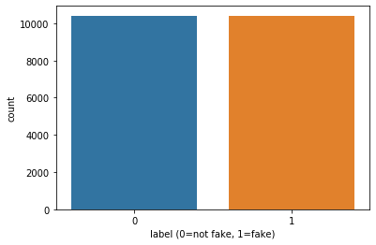
sns.countplot(x='label',data=train) plt.xlabel('label (0=not fake, 1=fake)') plt.show()

Slide 4
Code to see the loud words in fake news
#Getting sense of loud words in Fake
from wordcloud import WordCloud
fake = train['total'][train['label']==1]
fake_cloud = WordCloud(width=700,height=500,background_color='white',max_words=20).generate(' '.join(fake))
plt.figure(figsize=(10,8),facecolor='r')
plt.imshow(fake_cloud)
plt.axis('off')
plt.tight_layout(pad=0)
plt.show()

Slide 5
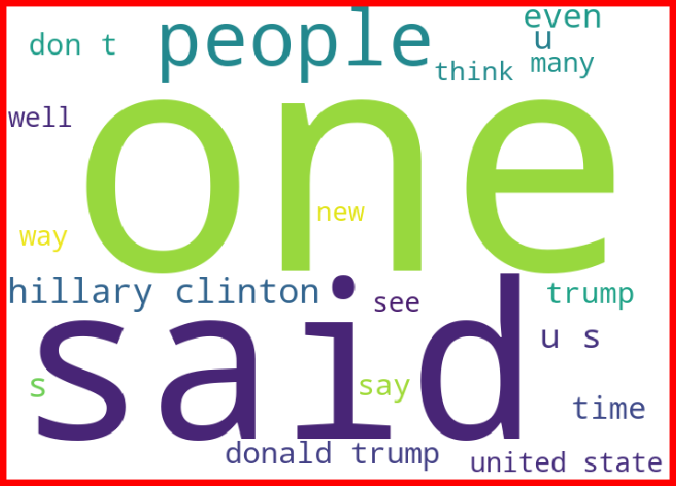
Loud words in Fake news

Slide 6
Code of loud words in Not Fake News
#Getting sense of loud words in Real
real= train['total'][train['label']==0]
real_cloud = WordCloud(width=600,height=400,background_color='white',max_words=50).generate(' '.join(real))
plt.figure(figsize=(10,8),facecolor='k')
plt.imshow(real_cloud)
plt.axis('off')
plt.tight_layout(pad=0)
plt.show()

Slide 7
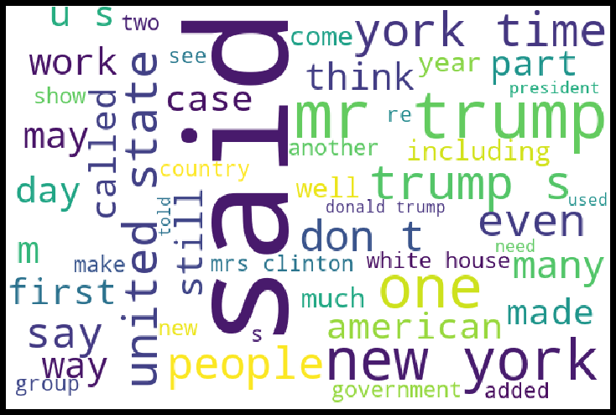
Loud words not in fake news

Slide 8
Logistic Regression Algorithm
#Logistic Regression
from sklearn.linear_model import LogisticRegression
logreg = LogisticRegression()
logreg.fit(X_train, y_train)
Accuracy = logreg.score(X_test, y_test)
Accuracy
0.9615384615384616

Slide 9
MultinomialNB Algorithm
# Naive Bayes
from sklearn.naive_bayes import MultinomialNB
NB = MultinomialNB()
NB.fit(X_train, y_train)
Accuracy = NB.score(X_test, y_test)
Accuracy
0.8803846153846154

Slide 10
Decision Tree Classifier
#Decision Tree Classifier
from sklearn.tree import DecisionTreeClassifier
clf = DecisionTreeClassifier()
clf.fit(X_train, y_train)
Accuracy = clf.score(X_test, y_test)
Accuracy
0.9634615384615385

Slide 11
Kneighbors Classifier
# KNeighbors Classifier
from sklearn.neighbors import KNeighborsClassifier
KNN=KNeighborsClassifier(n_neighbors=6)
KNN.fit(X_train, y_train)
Accuracy = KNN.score(X_test, y_test)
Accuracy
0.8509615384615384

Slide 12
Conclusion
From this dataset I get to know that each feature play a very import role to understand the data. Data format plays a very important role in the visualization and Appling the models and algorithms. Reprocessing and data cleaning is the very import step than after only you will get the best accuracy score of the model
The power of visualization is helpful for the understanding of data into the graphical representation its help me to understand that what data is trying to say, Data cleaning is one of the most important step to remove missing value or null value fill it with appropriate method Various algorithms I used in this dataset and to get out best result and save that model . algorithm works best in according to this given data the best algorithm is Logistic Regression.

